Slide 1

Chapter 2 The Individual Entrepreneurial Mind-Set

Slide 2
Common Characteristics Associated With Entrepreneurs
Total commitment, determination, and perseverance.
Drive to achieve and grow.
Opportunity and goal orientation.
Taking initiatives and personal responsibility.
Persistent problem solving.
Seeking and using feedback.
Internal locus of control.
Calculated risk taking and risk seeking.
low need for status and power.
Integrity and reliability.

Slide 3
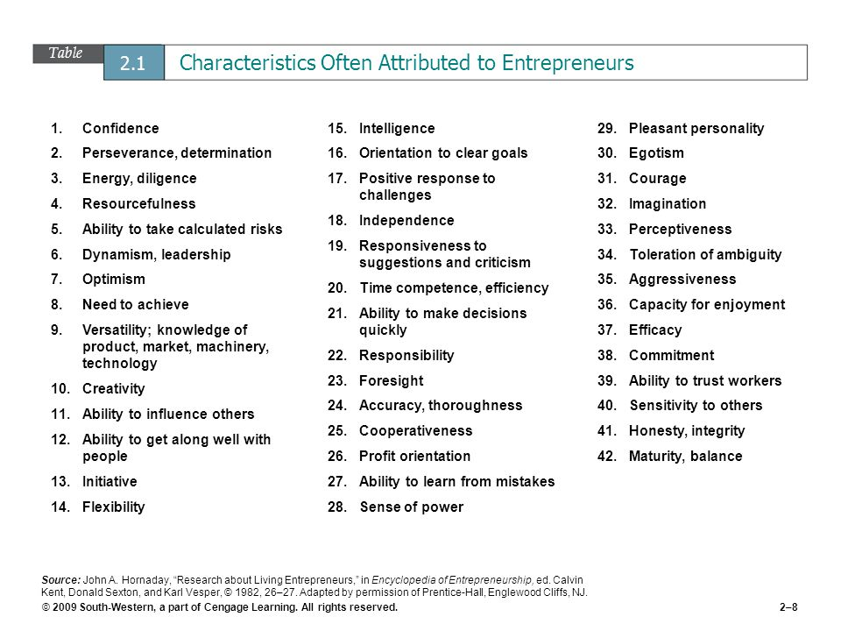

Slide 4
Part 1 of Project (based on slide 3)
Skills that you already have | Skills that you want to develop

Slide 5

The Dark Side of Entrepreneurship

Slide 6
The Dark Side of Entrepreneurship
You will no longer have the social life.
Your diet is going to suffer.
You will have to be ready for the failure.
You might have to live without money.
You will have to wait for making money.
The risk taking part could be Nerve-wracking.

Slide 7
The Entrepreneur’s confrontation with Risk
Financial Risk.
Career Risk.
Psychic Risk.
Stress (and its sources)
Loneliness.
Immersion in business (long working hours).
People problems.
Need to achieve.
Communicating with employees.
Delegating.
Unrealistic optimisms.

Slide 8
Characteristics of High Achievers
They take personal responsibility for their actions.
They are moderate risk takers.
Study a situation before committing themselves to a course of action.
Work on his or her own.
Like challenges but not high risks.
Like to accomplish goals.
To do constructive things that help them improve themselves.

Slide 9
Case 2.1 (Jane’s Evaluation)
Paul Medwick is a commercial banker. In the past month, he has received loan application from three entrepreneurs. All three have fledgling businesses with strong potentials. However, Paul believes it is important to look at more than just the business itself; the individual also needs close scrutiny.
The three entrepreneurs are (1) Robin Wood, owner of a small delicatessen located in the heart of a thriving business district: (2) Richard Trumpe. Owner of a ten-minute oil change and lube operation; and (3) Phil Hartack, owner of a bookstore that specializes in best sellers and cookbooks.

Slide 10
Case 2.1 (Jane’s Evaluation)
3. Paul has had the bank’s outside consultant, Professor Jane Jackson, interview each of the three entrepreneurs. Jane has done a lot of work with entrepreneurs and after a couple of hours of discussion – usually can evaluate a person’s entrepreneurial qualities. In the past, jane has recommended 87 people for loans, and only two of these ventures have failed. This success rate is much higher than that for commercial loans in general.

Slide 11
Case 2.1 (Jane’s Evaluation)
Characteristic | Robin Wood | Richard Trumpe | Phil Hartack
Perseverance | H | M | M
Drive to achieve | M | H | M
Initiative | M | H | M
Persistent Problem Solving | M | M | H
Tolerance for ambiguity | L | M | H
Integrity and reliability | H | M | H
Tolerance for failure | H | H | H
Creativity and innovativeness | M | H | M
Self - Confidence | H | H | H
Independence | H | H | H

Slide 12
Case 2.1 (Jane’s Evaluation)
Questions:
Which of three applicants do you think comes closet to having the mind-set of an ideal entrepreneurial? Why?
To which applicant would you recommend that the bank lend money? (Assume that each has asked for a loan of $ 10,000) Defend your answer.
Can these three entrepreneurs do anything to improve their entrepreneurial profile and their changes for success ? Be specific in your answer.

Slide 13


